Slide 2
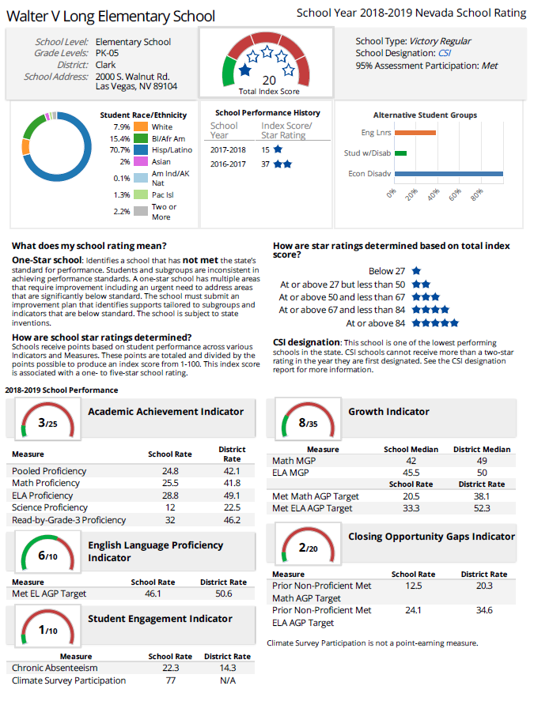
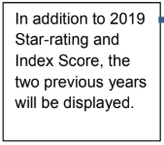
Highlights
7 points away from 2 STARS!
5 point increase from 2017-2018 school year!
Comprehensive Support & Improvement (CSI) - Long works with The Nevada Department of Education and School Improvement Department to meet CSI requirements.

Slide 5
Get Involved
Volunteer in the Parent Center
Help with events like Fall Festival on Friday, October 18, 2019
Help with Cinco de Mayo Garden Party on Friday, May 1, 2020

Slide 6
2. Demonstrate a positive attitude
When we are excited and positive, our children are excited and positive!

Slide 7
3. Develop a partnership with your child’s school
Parent-Teacher Conferences, Week of November 11, 2019.
Sign-Up with Class Dojo.
“Like” our school’s Facebook page.
Check your child’s backpack on a daily basis for important papers.
Visit our school website: https://www.long-ccsd.net

Slide 8
4. Support your child’s learning at home
Monitor your child’s television, video games, and internet use.
Encourage your child to read.
Talk with your child.
Encourage your child to be responsible and work independently.
Encourage active learning.

Slide 9
5. Get informed and be an advocate for your child
Ask questions.
Communicate with your child’s teacher and school staff.
What can you do to help your child succeed?

Slide 10
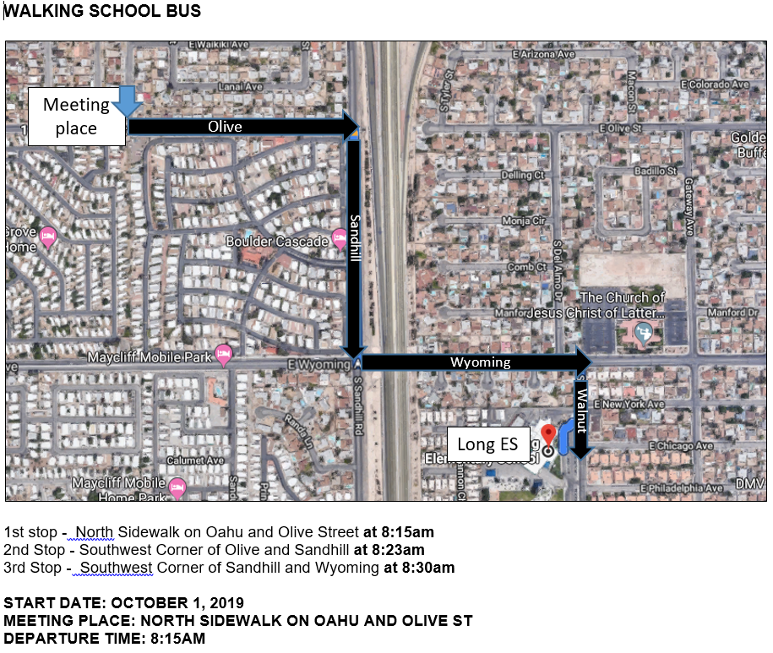

Slide 11
Fall Festival - Friday, October 18, 2019
Volunteer
Decorate
Food preparation
Set-Up
Clean-Up

